Slide 1

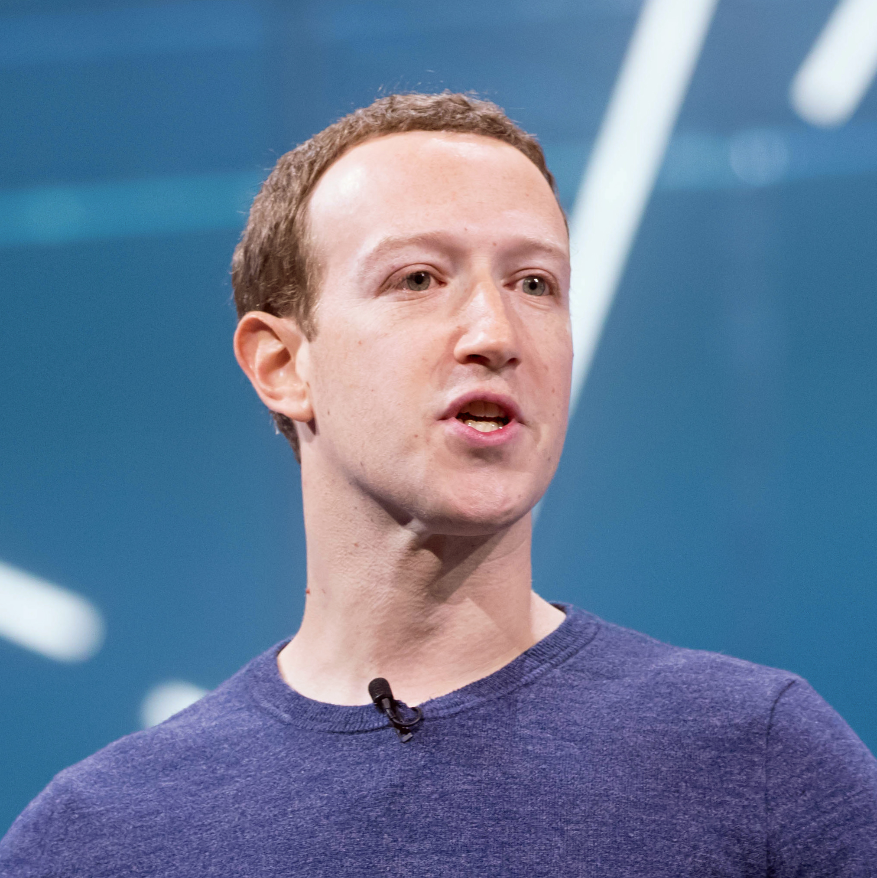
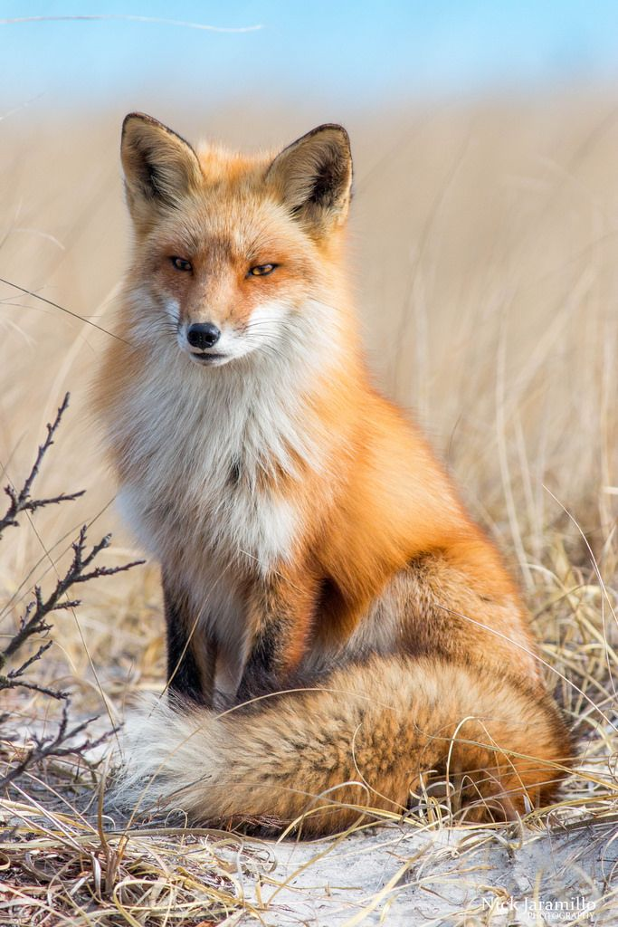
Mark ZUCKERBERG
Founder & General director of Facebook
Meta
MILLAN Romain – B.U.T. Informatique 1er Année/S6

Slide 2
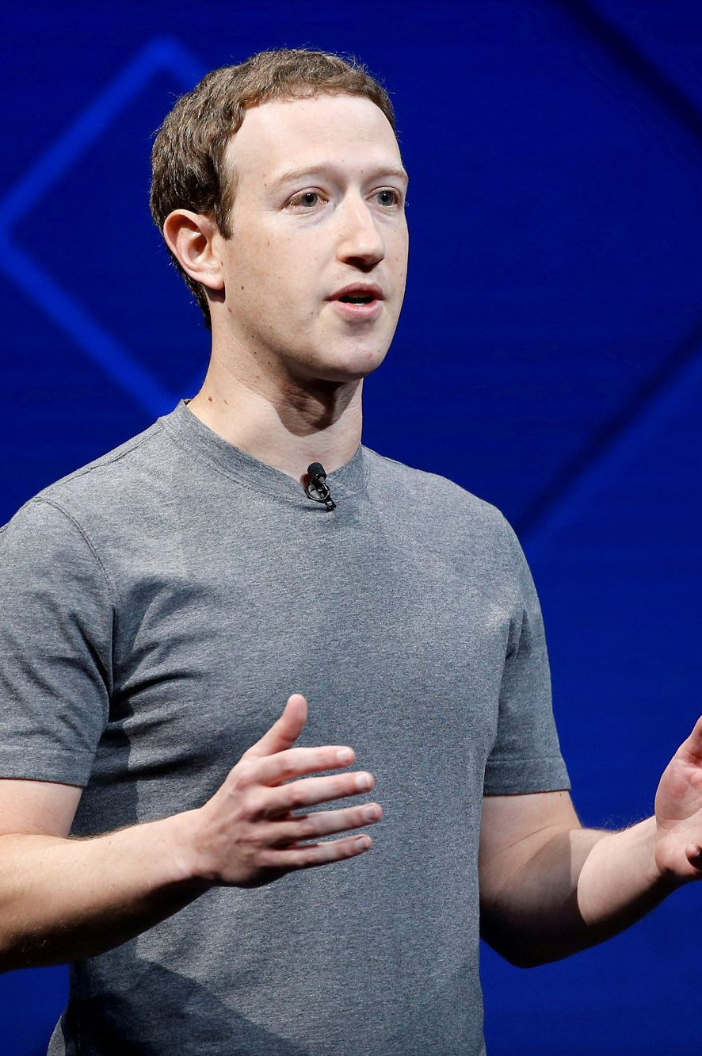
His History
Born on May 14, 1984 at White Plains (New York).
He is color blind.
At 12 years old, he started to code.
The first program is ZuckNet.
Studied at Havard but dropped out.

Slide 3
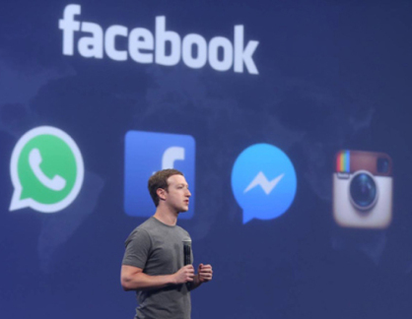
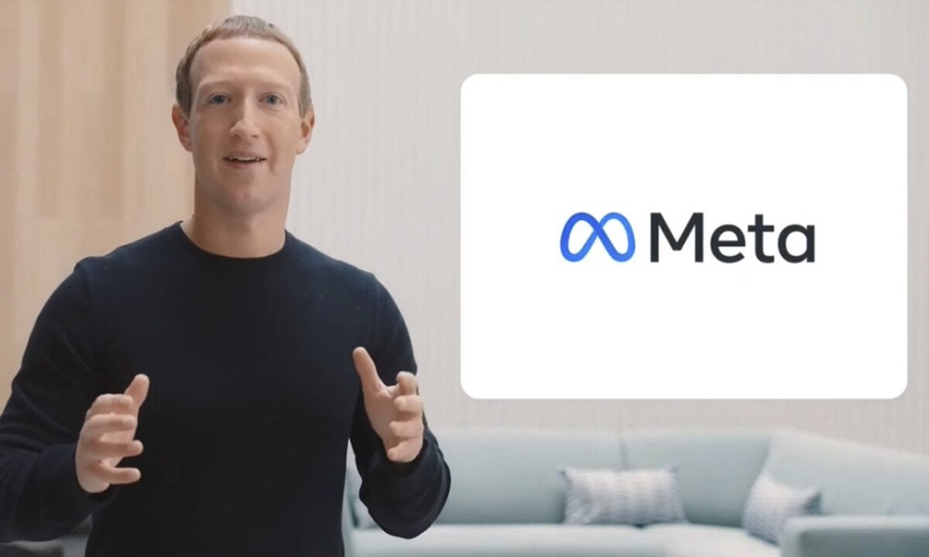
Facebook & Meta
Creators of Facebook: Mark ZUCKERBERG, Eduardo SAVERIN, Dustin MOSKOVITEZ and Chris HUGHES.
Started the first version the February 4, 2004.
End of 2005, 6 Millions of profils are created and surpassed MySpace.
He bought Instagram, What’s App & create Messenger with The Facebook company.
Creation of Meta to replace the Facebook company.

Slide 4
Thank you for listening
If you have question … I’am here !

Slide 5
Bibliography
L’internaute: https://www.linternaute.fr/actualite/biographie/1776230-mark-zuckerberg-biographie-courte-dates-citations/
Futura Sciences: https://www.futura-sciences.com/tech/personnalites/facebook-mark-zuckerberg-1684/
Wikipédia has been use.

Slide 6
Quiz

Slide 7


Quizz
Question n°1
Why Mark ZUCKERBERG chose the blue color for his company Facebook ?
Because he is color blind.
Because he is color blind.
The blue is her favorite color.
The blue is her favorite color.
He chose the color randomly.
He chose the color randomly.

Slide 8
Quizz
Question n°2
When the first version of ‘The Facebook’ are been launched ?
February 15, 2005.
February 15, 2005.
May 31, 2004.
May 31, 2004
February 4, 2004.
February 4, 2004.

Slide 9
Quizz
Question n°3
When Mark ZUCKERBER started to code ?
At 17 years old.
At 17 years old.
November 25, 2004.
November 25, 2004.
At 12 years old.
At 12 years old.

